Slide 1
신호 최적화 최종발표
ETRI연구연수생 강민수

Slide 2
Contents
Current Model
3x3Grid Single-Agent Model without Constraints(Depreciated)
3x3Grid Decentralized Model without Constraints(Depreciated)
3x3Grid/Dunsan Decentralized Model with Practical Constraints
Dunsan Decentralized CNN/CNN-reduced Model with Practical Constraints
Upcoming Model
Continuous Action Model with Practical Constraints

Slide 3
3x3Grid Single-Agent/Decentralized Model without Constraints(Depreciated)
Condition (seed fixed)
Generating probability 0.133 (left, right), 0.388 (up, down)
Restricted direction of vehicles(via)/Not restricted direction(no via)
Central agent(n_1_1), 9 Agents(decentralized)
State
The number of inflow vehicles from each inflow edge(left, straight)
Action
Deciding next phase(without an order), every 20s (with all yellow 3 seconds)
Reward
Penalty on Pressure (= inflow-outflow)

Slide 4
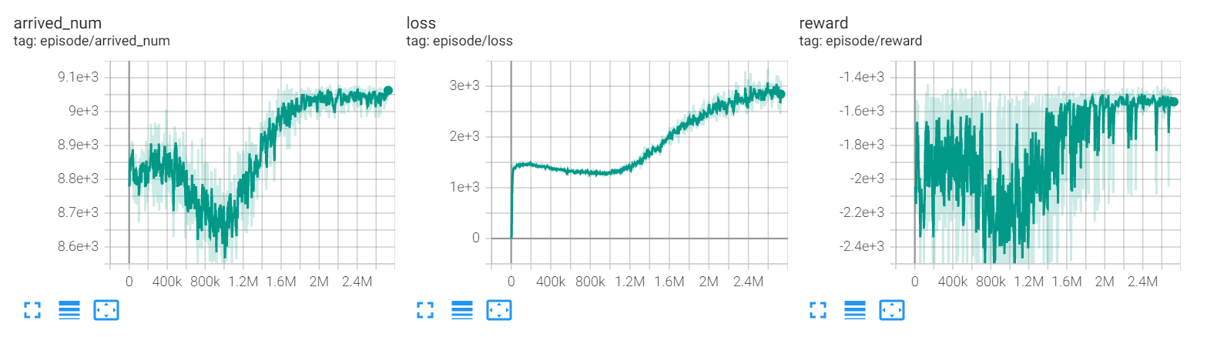

Comparison between Simulation & Single Agent
Simulation 0.133 (left, right), 0.388 (up, down), phase 42(G), 3(Y)
The number of arrived number: 8295 (no via), 8794 (via)
Experiment(Single-Agent Model)
The number of average arrived number: 9060 (no via), 9281 (via)
5~8% Increase
Agent
300m

Slide 5
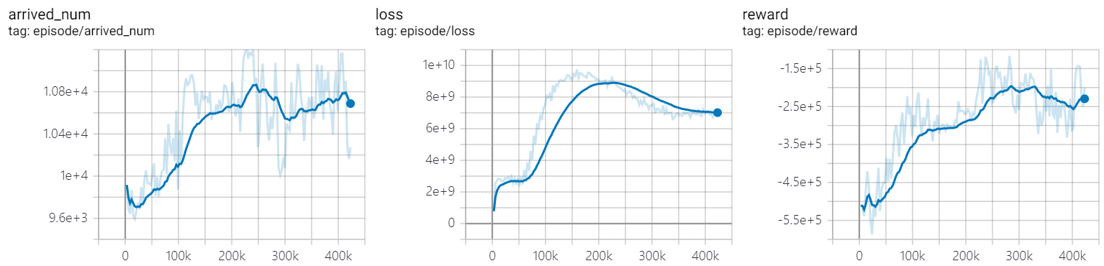
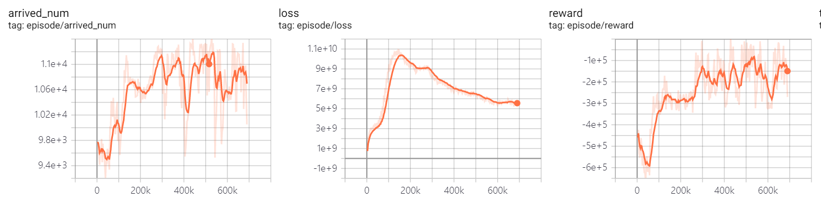
Comparison between Simulation & Decentralized Agents
Simulation 0.133 (left, right), 0.388 (up, down), phase 20(G), 3(y)
The number of arrived number: 9474 (no via), 9765(via)
Experiment(Decentralized Agents Model)
The number of avg arrived number: 10600(no via, blue), 10800 (via, orange)
10~11% Increase

Slide 6
3x3Grid Decentralized Model with Practical Constraints
Condition(seed fixed)
Random routing vehicle generation (period 0.8), scale 1.1 (by randomTrips.py)
9 Decentralized Agents(No offsets, Update Asynchronously)
4 Phases(Vertical/Horizontal straight and left) 37s each, followed by all yellow 3s
Model applied min/max duration(28s,49s) and phase period(160s)
State
The number of inflow vehicles from each inflow edge(left, straight)
Update phase demand(# of vehicles inflow) from end of phase period

Slide 7
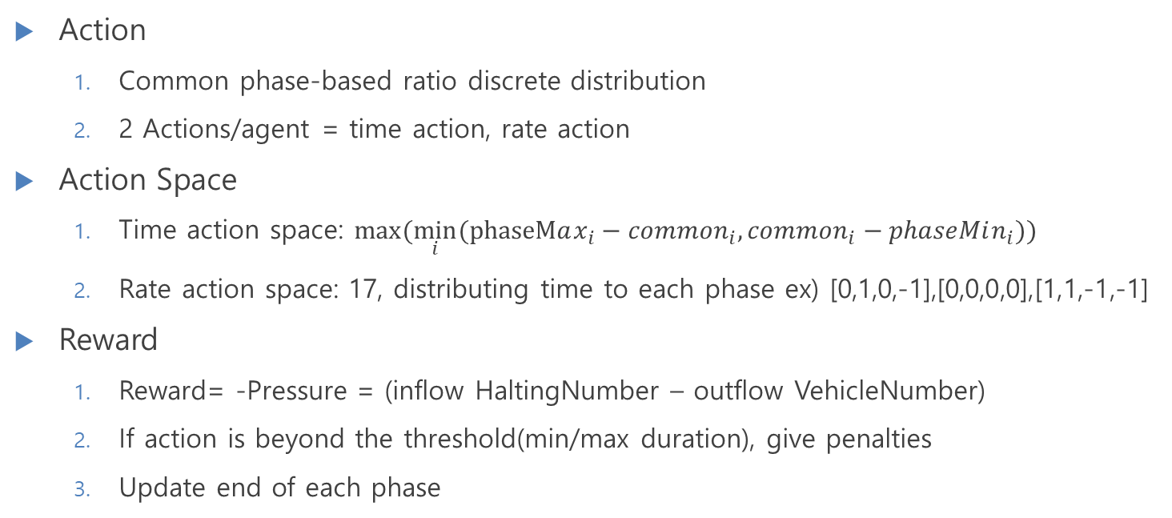
3x3Grid Decentralized Model with Practical Constraints
Action
Common phase-based ratio discrete distribution
2 Actions/agent = time action, rate action
Action Space
Time action space: $max⁡(\min_{i}⁡(phaseMax_{i}−common_{i},common_{i}−phaseMin_{i}))$
Rate action space: 17, distributing time to each phase ex) [0,1,0,-1],[0,0,0,0],[1,1,-1,-1]
Reward
Reward= -Pressure = (inflow HaltingNumber – outflow VehicleNumber)
If action is beyond the threshold(min/max duration), give penalties
Update end of each phase

Slide 8




Decentralized Model with Practical Constraints
Action: $a_{t}^{i}$
RL Modeling
Agent
Agent
Agent
Agent
Environment
Traci
State:$s_{t}$
Neural Net (shared params)
Update Mask
$$i$$
TL_Period
Reward: $r_{t}^{i}$

Slide 9
Decentralized Model with Practical Constraints
# of phase | Action space
2 | 2
3 | 7
4 | (4C2)*2+4+1
5 | 5C2+5C4+1
DNN Modeling
Neural Net (Shared Params)
Left Straight
argmaxQ = rate action
Vehicle Info from Traci
Rate Q Network
argmaxQ = time action
Intersection Traffic Demand
Super Q Network
Time Q Network
Concatenated
Traffic Demand
Other Agents
Inflow Demand

Slide 10
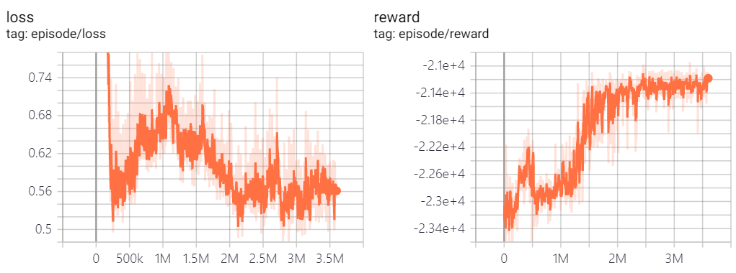
Decentralized Model with Practical Constraints
3x3 grid
9 Agents
Random Routing Generation → 1 period, 1.5 scaled
Dunsan
11 Agents
Real Demand based training → 0-3am, 2.0 scaled
Avg Value | Simulation | Decentralized
Travel Time (per edge) | 61.0s
Velocity | 3.43m/s
Waiting Time (whole trip) | 40.2s/veh
Avg Value | Simulation | Decentralized
Travel Time (per edge) | 13.82s | 14.52
Velocity | 5.93m/s | 5.769m/s
Waiting Time (whole trip) | 495.5s/veh | 534.1s/veh
Arrived Num | 10951 | 10863

Slide 11
Dunsan Decentralized CNN/CNN-reduced Model with Practical Constraints
CNN based Decentralized Model
CNN: Convolution Neural Network
Feature extraction in selected region → Apply to intersection information
Advantage: less parameters than Fully Connected Network → Lightweighting
CNN based Model (Feature Extraction)
Current Channel: 8 (zero-padded demand of vehicles from inflow edge)
After CNN, the number of channel: 16
Learning Time: 8h 11m
CNN based Lightweight Model
By using Conv1d, dimensionality reduced to 1 channel with feature
Learning Time: 6h 10m

Slide 12
Dunsan Decentralized CNN/CNN-reduced Model with Practical Constraints
CNN based model(Single Agent based Model)
Neural Net (Shared Params)
Left Demand Straight Demand
argmaxQ = rate action
Vehicle Info from Traci
Conv1d
Rate Q Network
argmaxQ = time action
Intersection Traffic Demand
8 Activation Maps/
1 Activation Map
Super Q Network
Time Q Network
Other Agents
Concatenated
Traffic Demand
Other Agents
Inflow Demand (Zero Padded)

Slide 13
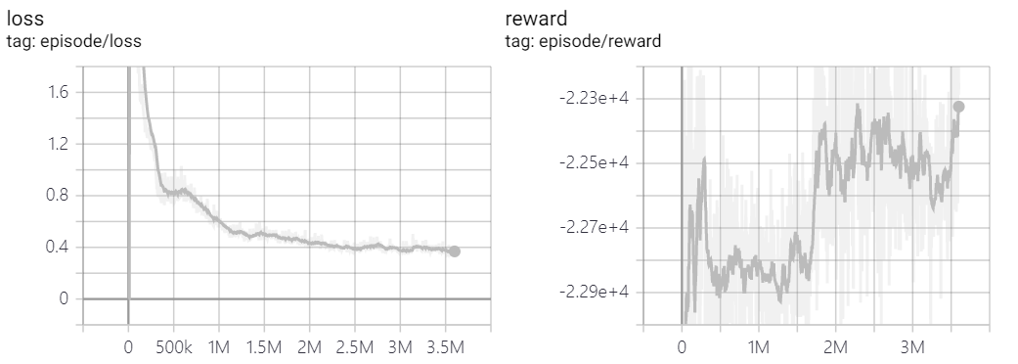
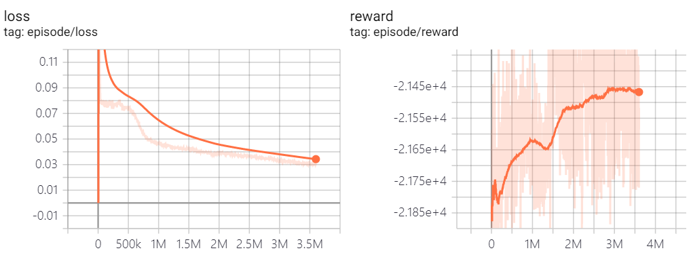
Dunsan Decentralized CNN/CNN-reduced Model with Practical Constraints
CNN Model(0to3am)
8 feature → Checking demand change
CNN-reduced Model(0to3am)
1 feature → Current traffic info
Avg Value(interest edges) | Simulation | Decentralized-CNN | Decentralized-CNN-reduced
Travel Time (per edge) | 13.82s | 14.5s | 14.4s
Avg Velocity(edge veh) | 5.93m/s | 5.79m/s | 5.80m/s
Waiting Time (during whole trip) | 495.5s/edg | 534s/edg | 530s/edg
Arrived Num (all edge) | 10951 | 11022 | 11024

Slide 14
Dunsan Decentralized CNN/CNN-reduced Model with Practical Constraints
Avoiding Local Optimum
Add Dropout Layer between fully connected layer in super Q Network
Apply peak demand(7-10am) to the model learned from free demand(0-3am)
Avg Value | Simulation | Before adding dropout | After adding dropout
Travel Time (per edge) | 35.942s | 39.716s | 36.102s
Velocity(edge veh) | 5.413m/s | 5.187m/s | 5.417m/s
Waiting Time (whole trip) | 24.7s/veh | 27.0s/veh | 25.2s/veh
Arrived Num | 12111 | 11873 | 12179

Slide 15
Dunsan Decentralized CNN/CNN-reduced Model with Practical Constraints
Practical Constraints without minimum of duration condition
Removing penalty in action that is less/more than min/maximum length of duration
Purpose: Verifying whether regulations lead traffic jam or not
Learning process and Reward comparison

Slide 16
Analysis
With Practical Constraints
Phase length locked action space
Phase length unlocked action space
Normalized vs. Pure info
Learning Results
Similar performance between Validation and Learning results

Slide 17
Reason for failing experiment
Actual data biased for fixed time signal control
Congested road conditions not being reflected by scaled data → Using 7-10am demand instead of 0-3am
Fixed offset value

Slide 18


Continuous Action Model with Practical Constraints
DDPG based Model
Current action space: Time, Rate → Phase length (for each phase)
Splitting rest of time (Total TL period – sum of min durations for each phase)
Phase distribution by the results of softmax($a_{i}$)
Sum of results by softmax function = 1 → Easy to distribute length of phase
DDPG
DDPG target
Action
Update, Approx.
Actor
Actor
Soft Update
$$a_{i}$$
Critic
Critic
Min Duration
State
Environment

Slide 19
Thank you

